Slide 1
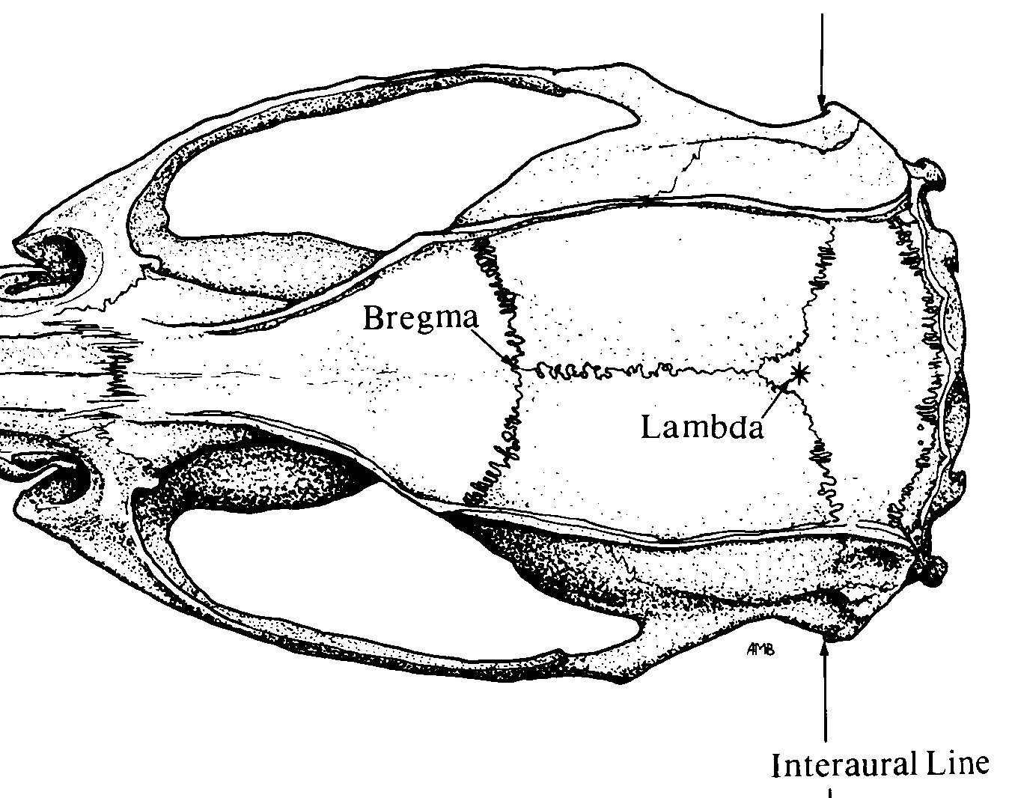

Pinnacle 3-Channel layout
Implant Map
Pin-out
1 GND | 2 EEG2 | 3 EEG3
4 COMM | 5 EEG1 | 6 REF-EEG3
White out
❺
❷
Bregma
Stereotaxic Coordinates
Location | Bregma | Midline
M1 | +1.1 (anterior) | ±1.5 (lateral)
Parietal | -2 (posterior) | +1.5 (lateral, right only)
❸
Lambda
❹
❻
❶
Adjust ratio $=\frac{Measured X B−L}{Reference X B−L}$

